Slide 1
Module 7
NOSQL
Introduction, Need of NoSQL, CAP Theorem, different NoSQL data bases: Key-value data stores, Columnar families, Document databases, Graph databases

Slide 2
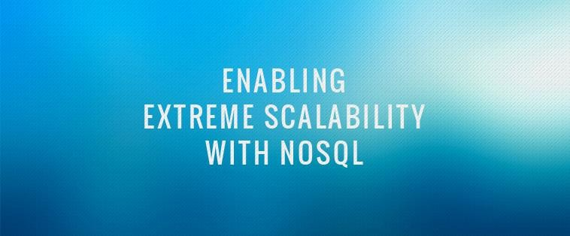






1

Slide 3
What is covered in this presentation?
A brief history of databases
NoSQL WHY, WHAT & WHEN?
Characteristics of NoSQL databases
Aggregate data models
CAP theorem

Slide 4
Introduction
Database - Organized collection of data
DBMS -
Database Management System: a software
package with computer programs that controls the creation, maintenance and use of a database
Databases are created to operate large quantities of information by inputting, storing, retrieving, and managing that information.

Slide 5
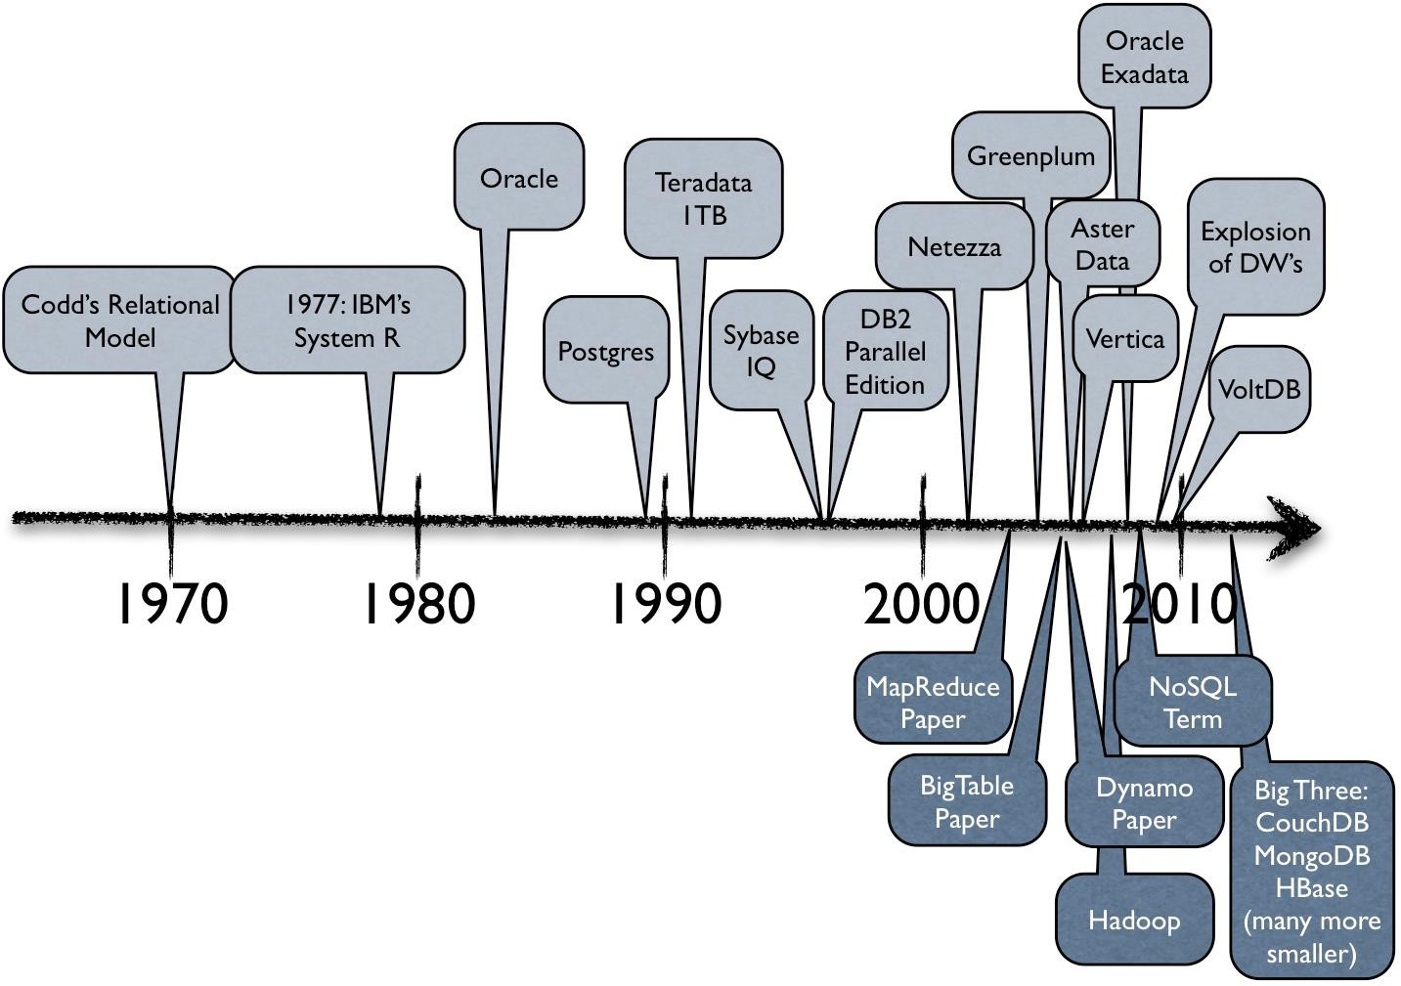
A brief history

Slide 6
Relational databases
Benefits of Relational databases:
Designed for all purposes
ACID
Strong consistancy, concurrency, recovery
Mathematical background
Structured Query language (SQL)
Lots of tools to use with i.e: Reporting services, entity frameworks, ...

Slide 7

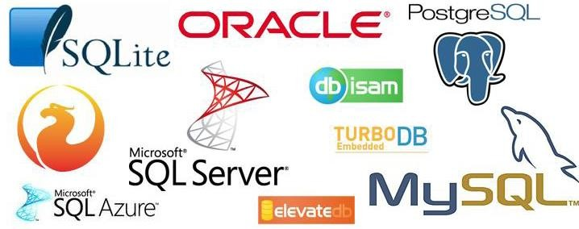
SQL databases

Slide 8

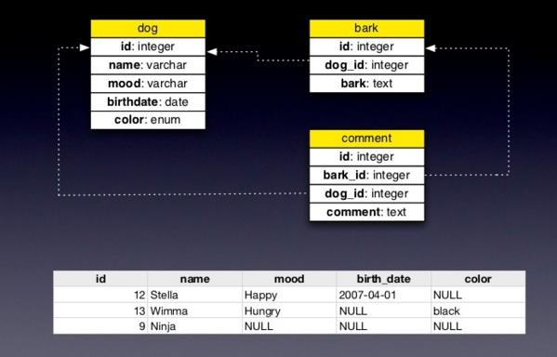
RDBMS

Slide 9

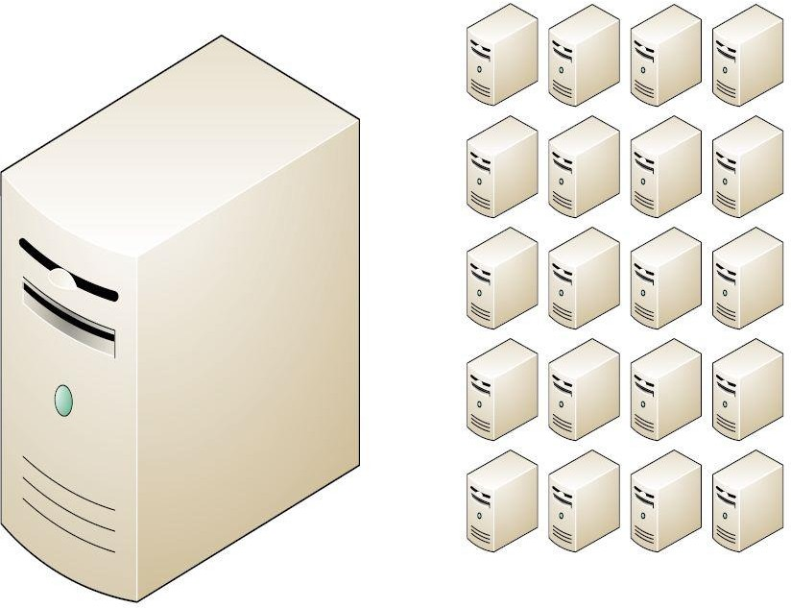
NoSQL why, what and when?
But...
Relational databases were not built
for distributed applications.
Because...
Joins are expensive
Hard to scale horizontally
Impedance mismatch occurs
Expensive (product cost, hardware, Maintenance)

Slide 10
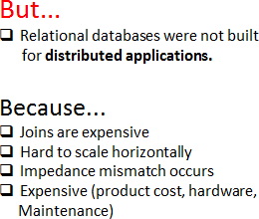
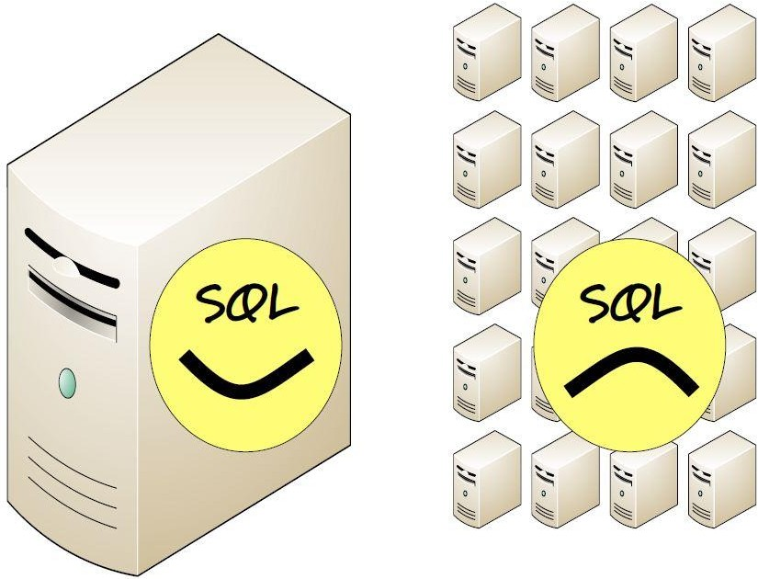
NoSQL why, what and when?
And....
It’s weak in:
Speed (performance)
High availability
Partition tolerance

Slide 11
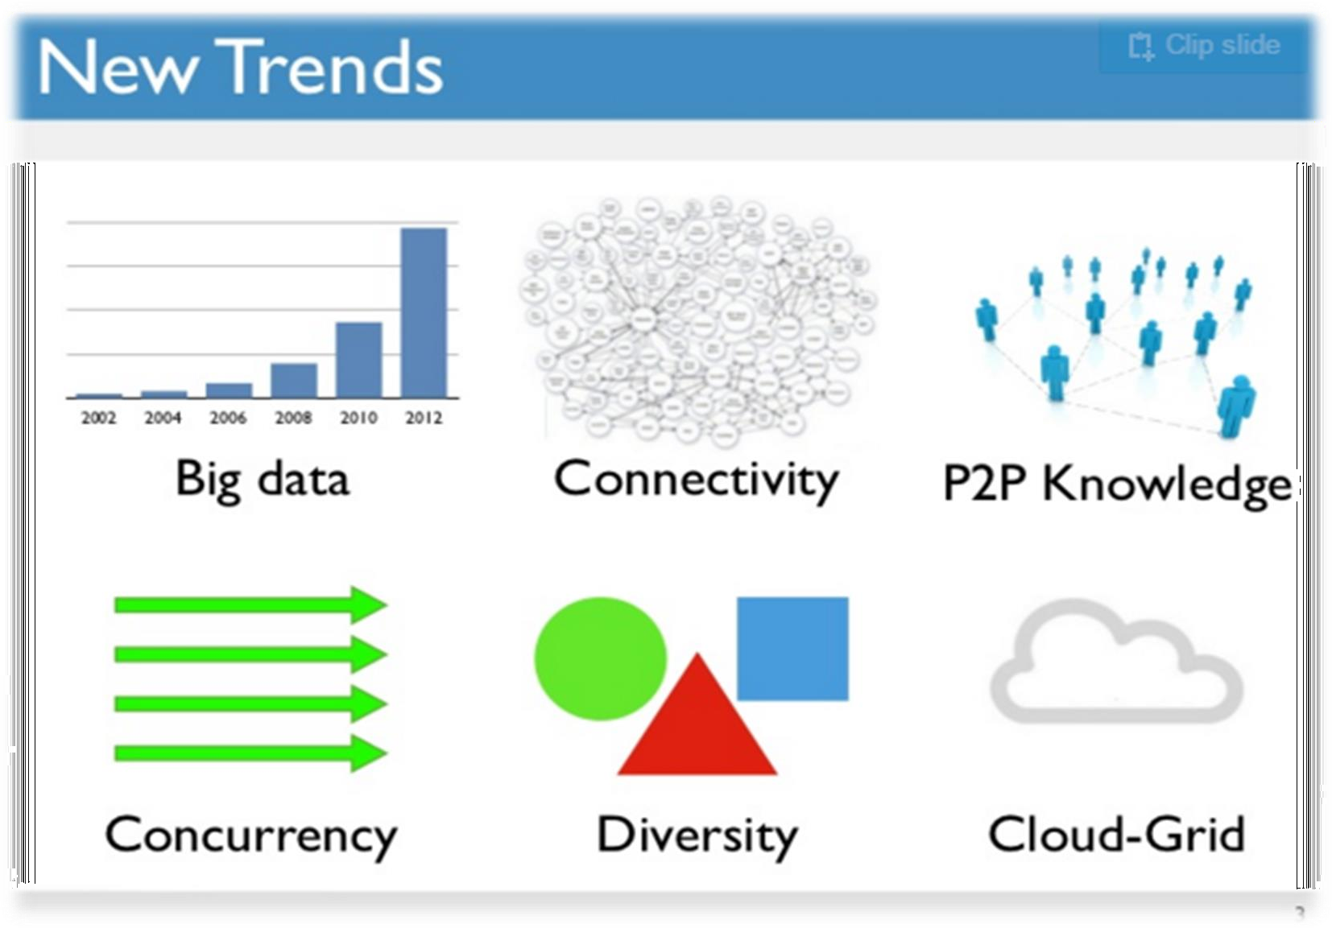
Why NOSQL now??
Ans:Driving Trends

Slide 12



But What’s N O S Q L ?
A No SQL database provides a mechanism for storage and retrieval of data that employs less constrained consistency models than traditional relational database
No SQL systems are also referred to as
"Not only SQL“ to emphasize that they do in fact allow SQL-like query languages to be used.

Slide 13
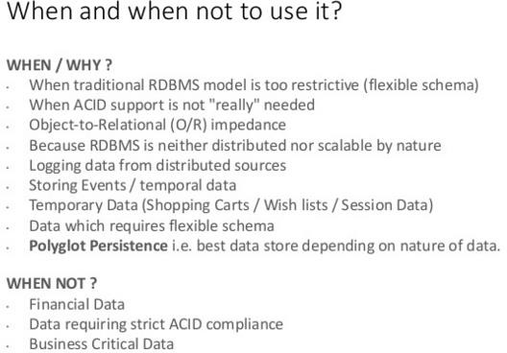
NoSQL why, what and when?

Slide 14
Why NOSQL?
Many applications need systems other than traditional relational SQL systems to augment their data management needs.
Most NOSQL systems are distributed databases or distributed storage systems and need:
Semi structured data storage,
High performance,
Availability,
Data replication, and
Scalability

Slide 15
Introduction to NOSQL Systems
Emergence of NOSQL Systems
Many companies and organizations are faced with applications that store vast amounts of data, example: e-mail application
They need lot of storage to manage all these e-mails; a structured relational SQL system may not be appropriate because (1) SQL systems offer too many services, where this application may not need; and
(2) A structured data model such the traditional relational model may be too restrictive

Slide 16
Introduction to NOSQL Systems
Emergence of NOSQL Systems
Another example:
Facebook, with millions of users who submit posts, many with images and videos.
User profiles, user relationships, and posts must all be stored in a huge collection of data stores
Some of the data for this type of application is not suitable for a traditional relational system and typically needs multiple types of databases and data storage systems.

Slide 17
Introduction to NOSQL Systems
Emergence of NOSQL Systems
Some of the organizations that were faced with these data management and storage applications decided to develop their own systems:
Google developed a proprietary NOSQL system known as BigTable - Gmail, Google Maps, and Web site indexing
Amazon developed a NOSQL system called DynamoDB that is available through Amazon’s cloud services - key-value data stores
Facebook developed a NOSQL system called Cassandra - uses concepts from both key-value stores and column-based systems

Slide 18
Introduction to NOSQL Systems
Emergence of NOSQL Systems…
MongoDB and CouchDB, which are classified as document-based NOSQL systems or document stores.
graph-based NOSQL systems or graph databases; these include Neo4J and GraphBase
Some NOSQL systems, such as OrientDB, combine concepts from many of the categories discussed above

Slide 19
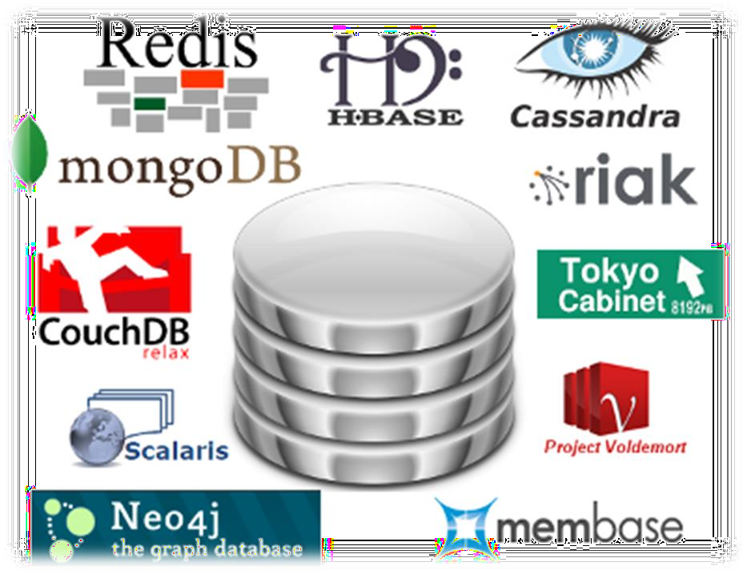
Characteristics of NoSQL databases
NoSQL avoids:
Overhead of ACID transactions
Complexity of SQL query
Burden of up-front schema design
DBA presence
Transactions (It should be handled at
application layer)
Provides:
Easy and frequent changes to DB
Fast development
Large data volumes(eg.Google)
Schema less

Slide 20
Characteristics of NOSQL Systems
NOSQL characteristics related to distributed databases and distributed systems.
1. Scalability – Horizontal vs Vertical ( adding more nodes for data storage Vs expand the storage and computing power )
2. High availability - data is replicated over two or more nodes but write is cumbersome.
3. Replication model – Master Slave and Master-Master models
Master slave requires one copy to be the master copy; all write operations must be applied to the master copy and then propagated to the slave copies – read can be done in master or slave copy
Master-master replication allows reads and writes at any of the replicas but may not guarantee consistency initially but a reconciliation method is used to resolve the conflicts

Slide 21
Characteristics of NOSQL Systems
NOSQL characteristics related to distributed databases and distributed systems.
4. Sharding of Files
Horizontal partitioning of file records i.e. distribute the load of accessing the file records to multiple nodes.
It improves load balancing as well as data availability
5. High-Performance Data Access
a. In hashing, a hash function h(K) is applied to the key K, and the location of the object with key K is determined by the value of h(K).
b. In range partitioning, the location is determined via a range of key values; for example, location i would hold the objects whose key values K are in the range Kimin ≤ K ≤ Kimax.

Slide 22
Characteristics of NOSQL Systems
NOSQL characteristics related to data models and query languages.
1. Not Requiring a Schema ( JSON, XML )
2. Less Powerful Query Languages
NOSQL systems may not require a powerful query language such as SQL
CRUD operations, for Create, Read, Update, and Delete or SCRUD – Search.
3. Versioning
Some NOSQL systems provide storage of multiple versions of the data items, with the timestamps of when the data version was created.

Slide 23
What is a schema-less data model?
In NoSQL Databases:
There is no schema to consider
There is no unused cell
There is no datatype (implicit)
Most of considerations are done in application layer
We gather all items in an aggregate (document)

Slide 24
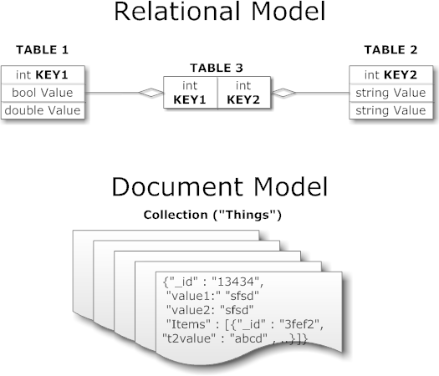
What is a schema-less data model?

Slide 25
Categories of NOSQL Systems
1. Document-based NOSQL systems:
These systems store data in the form of documents using well-known formats, such as JSON (JavaScript Object Notation).
Documents are accessible via their document id, but can also be accessed rapidly using other indexes.
2. NOSQL key-value stores:
These systems have a simple data model based on fast access by the key to the value associated with the key;
The value can be a record or an object or a document or even have a more complex data structure.

Slide 26
Categories of NOSQL Systems
3. Column-based or Wide based NOSQL systems:
These systems partition a table by column into column families where each column family is stored in its own files. They also allow versioning of data values.
4. Graph-based stores:
Data is represented as graphs, and related nodes can be found by traversing the edges using path expressions.
Additional categories: Hybrid NOSQL systems, Object databases, XML databases

Slide 27

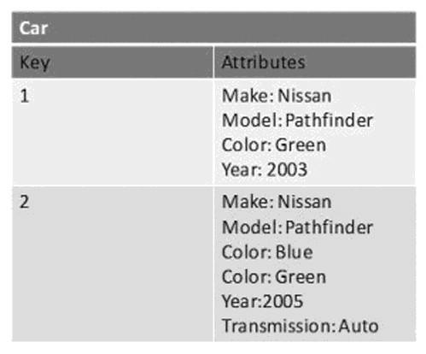

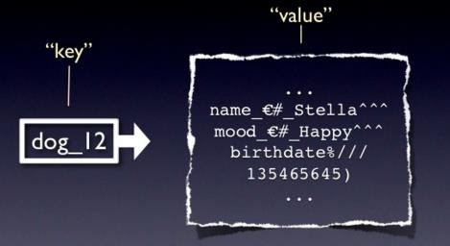

Key-value data model
Simplest NOSQL databases
The main idea is the use of a hash table
Access data (values) by strings called keys
Data has no required format data may have any format
Data model: (key, value) pairs
Basic Operations: Insert(key,value), Fetch(key), Update(key), Delete(key)

Slide 28
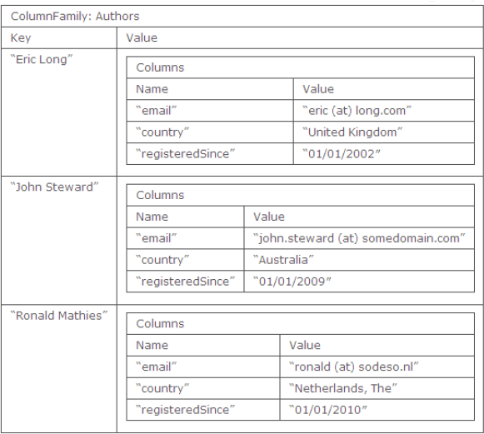

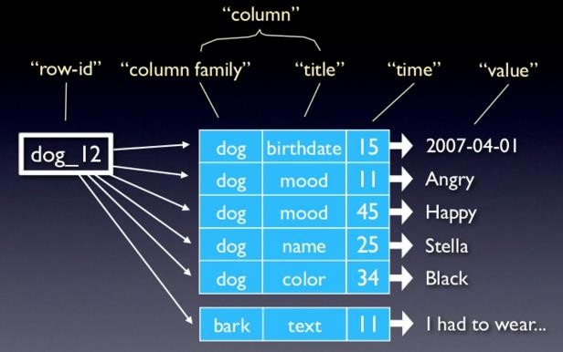
Column family data model
The column is lowest/smallest
instance of data.
It is a tuple that contains a name, a value and a timestamp

Slide 29





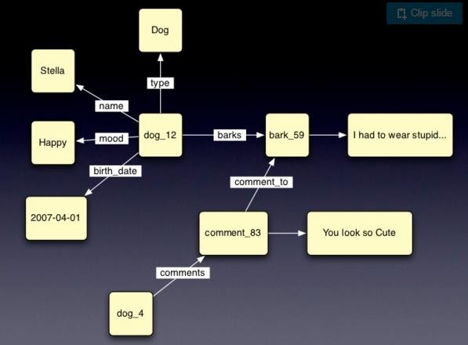


Graph data model
Building relationship between data elements
Based on Graph Theory.
Scale vertically, no clustering.
You can use graph algorithms easily
Transactions
ACID

Slide 30
Graph data
Graph data model
Very simply, a graph database is a database designed to treat the relationships between data as equally important to the data itself.
It is intended to hold data without constricting it to a pre-defined model.
Instead, the data is stored like we first draw it out - showing how each individual entity connects with or is related to others.

Slide 31
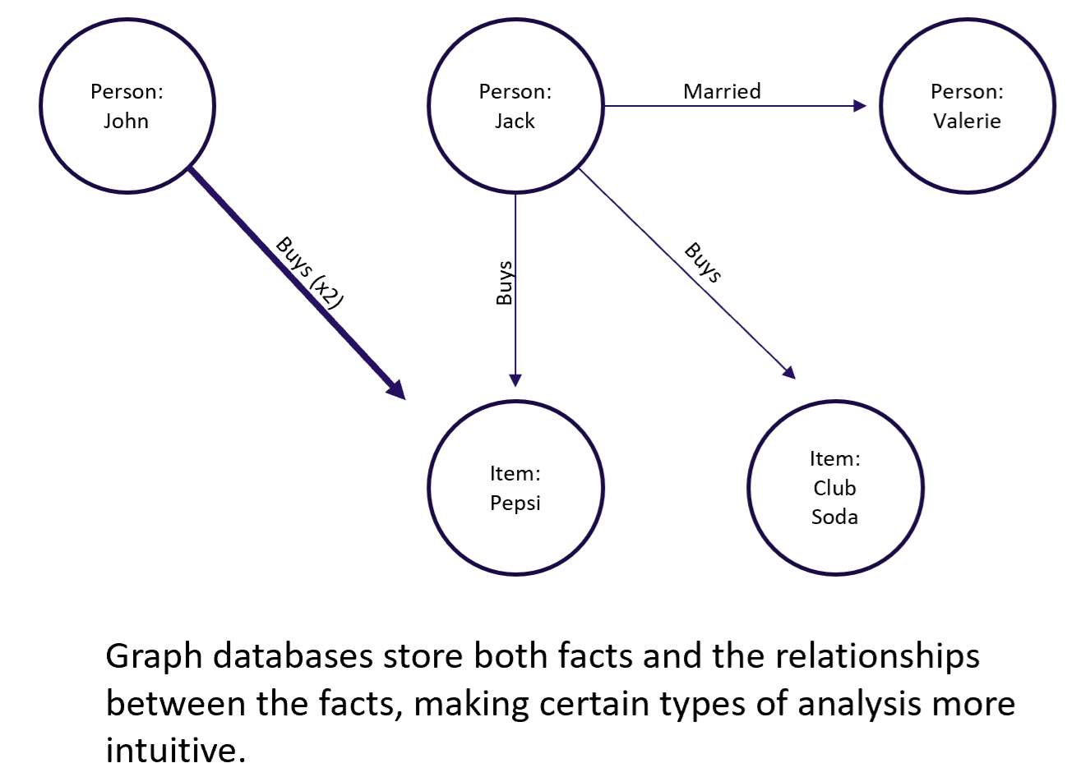

Graph data model

Slide 32
Graph data
Graph data model
What is Neo4j?
Neo4j is an open-source, NoSQL, native graph database that provides an ACID-compliant transactional backend for your applications.
Initial development began in 2003, but it has been publicly available since 2007.
The source code, written in Java and Scala, is available for free on GitHub.
Neo4j has both a Community Edition and Enterprise Edition of the database.
The Enterprise Edition includes all that Community Edition has to offer, plus extra enterprise requirements such as backups, clustering, and failover abilities.

Slide 33

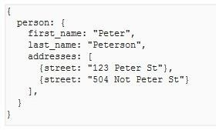


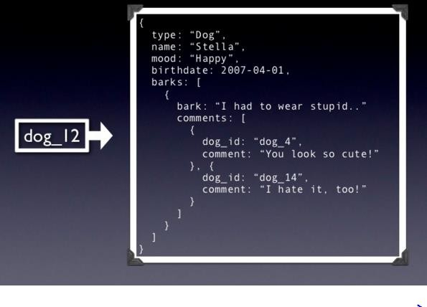
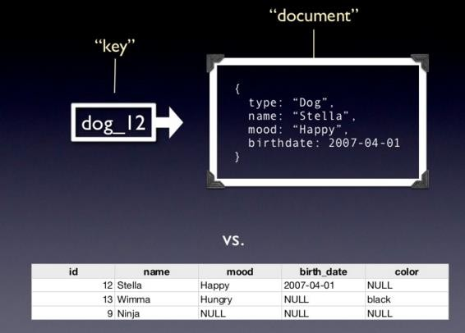
Document based data model
Pair each key with complex data structure known as data structure.
Indexes are done via B-Trees.
Documents can contain many different key-value pairs, or key-array pairs, or even nested documents.

Slide 34
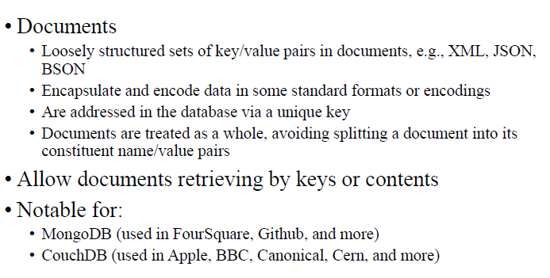
Document based data model

Slide 35
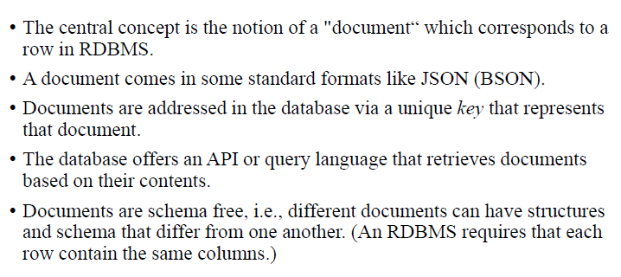
Document based data model

Slide 36
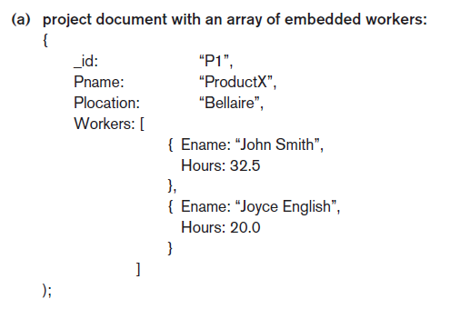
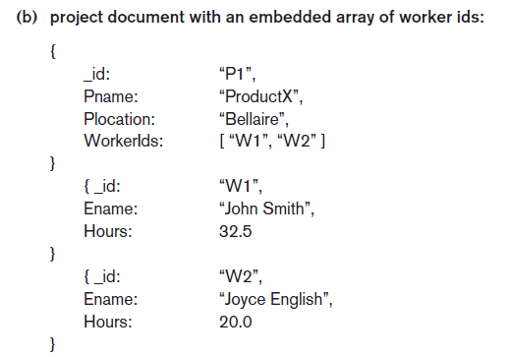
Document based data model

Slide 37
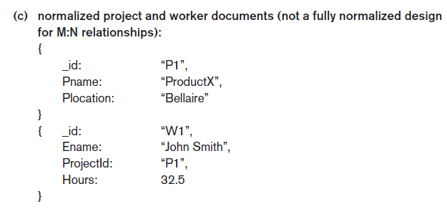
Document based data model

Slide 38
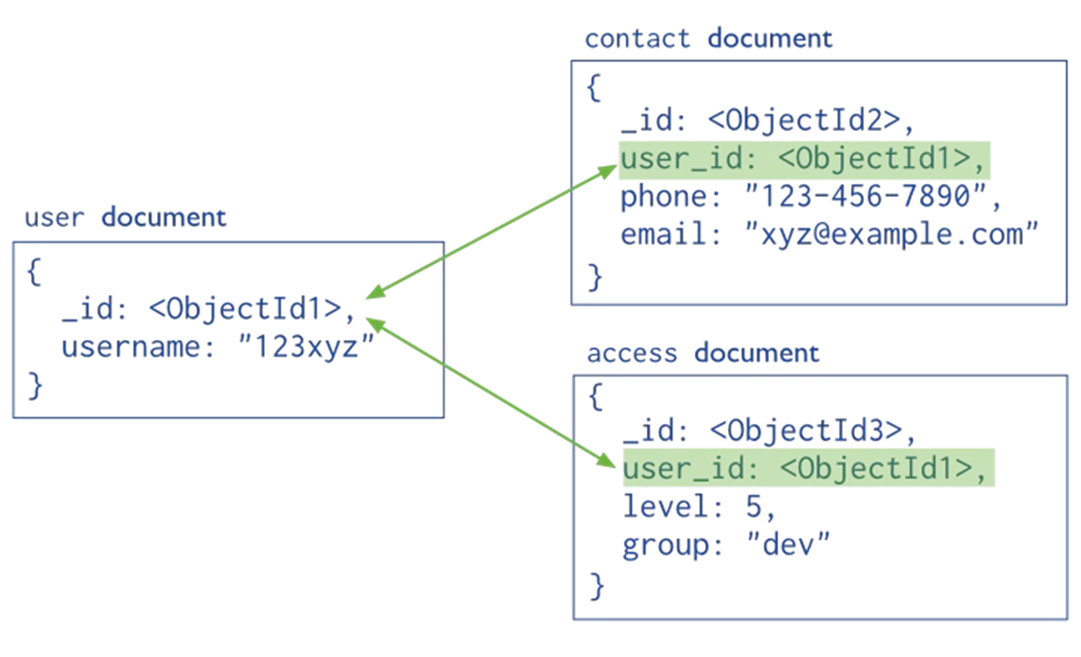
Document based data model

Slide 39
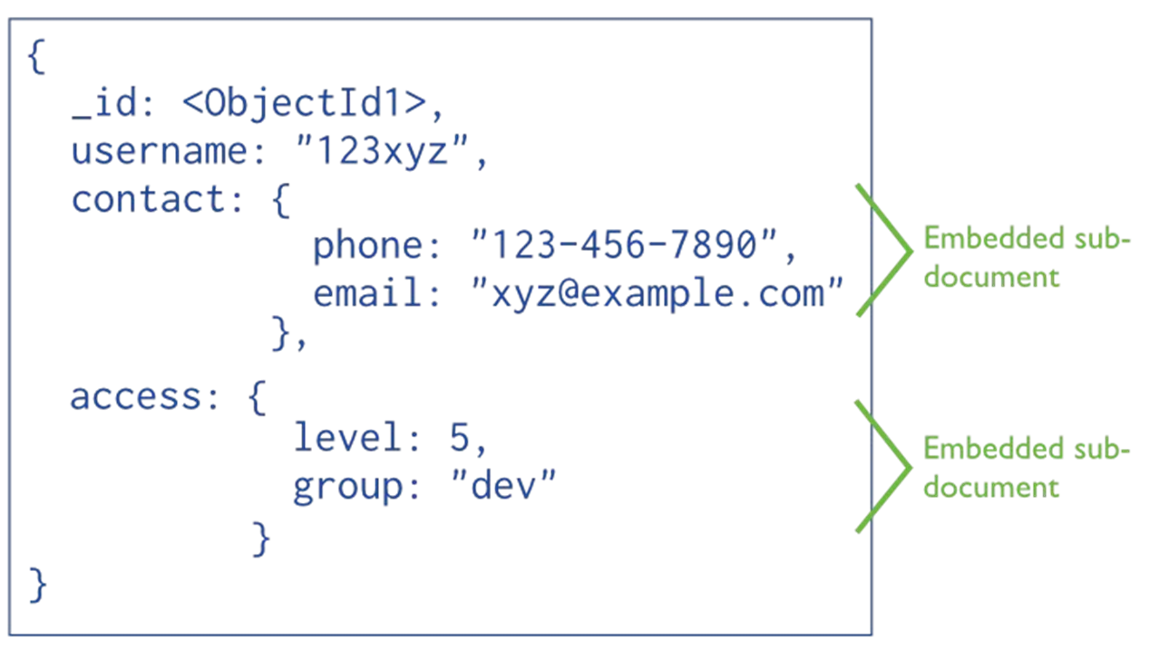
Document based data model

Slide 40
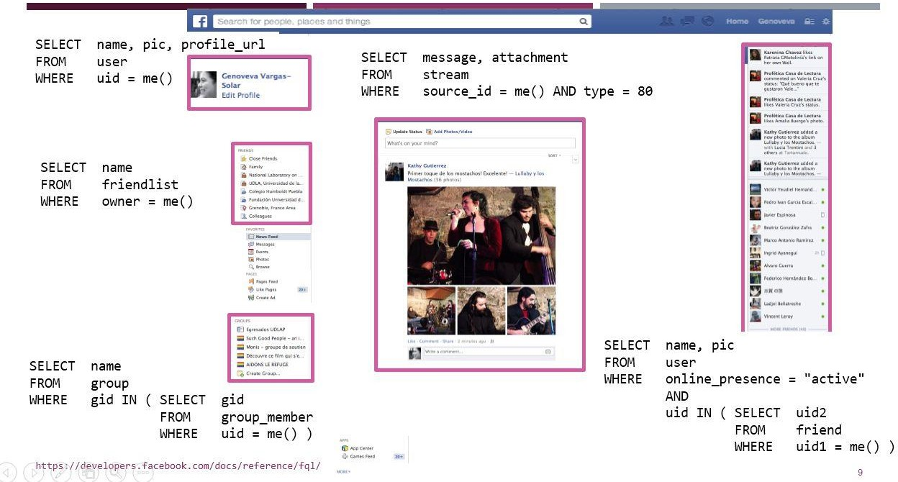
Document based data model

Slide 41
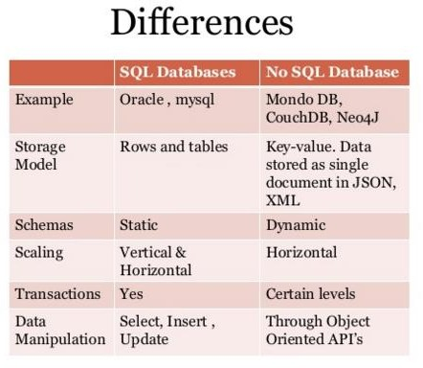
SQL vs NOSQL

Slide 42
What we need ?
We need a distributed database system having such features:
•
•
•
•
Fault tolerance
High availability
Consistency
Scalability
Which is impossible!!!
According to CAP theorem

Slide 43
CAP Theorem
In Distributed system with data replication, concurrency control becomes more complex because there can be multiple copies of each data item.
So if an update is applied to one copy of an item, it must be applied to all other copies in a consistent manner otherwise inconsistency occurs.
Distributed concurrency control methods that do not allow this inconsistency among copies of the same data item, thus enforcing serializability and hence the isolation property is ensured.

Slide 44
Why CAP Theorem?
However, these techniques often come with high overhead, which would defeat the purpose of creating multiple copies to improve performance and availability in distributed database systems such as NOSQL.
Distributed systems has various levels of consistency among replicated data items, from weak consistency to strong consistency.
Enforcing serializability is considered the strongest form of consistency, but it has high overhead so it can reduce performance of read and write operations and hence adversely affect system performance.

Slide 45
CAP Theorem
CAP refer to three desirable properties of distributed systems with replicated data:
Consistency,
Availability and
Partition tolerance

Slide 46
CAP Theorem
Availability means that each read or write request for a data item will either be processed successfully or will receive a message that the operation cannot be completed.
Partition tolerance means that the system can continue operating if the network connecting the nodes has a fault that results in two or more partitions, where the nodes in each partition can only communicate among each other.
Consistency means that the nodes will have the same copies of a replicated data item visible for various transactions.

Slide 47
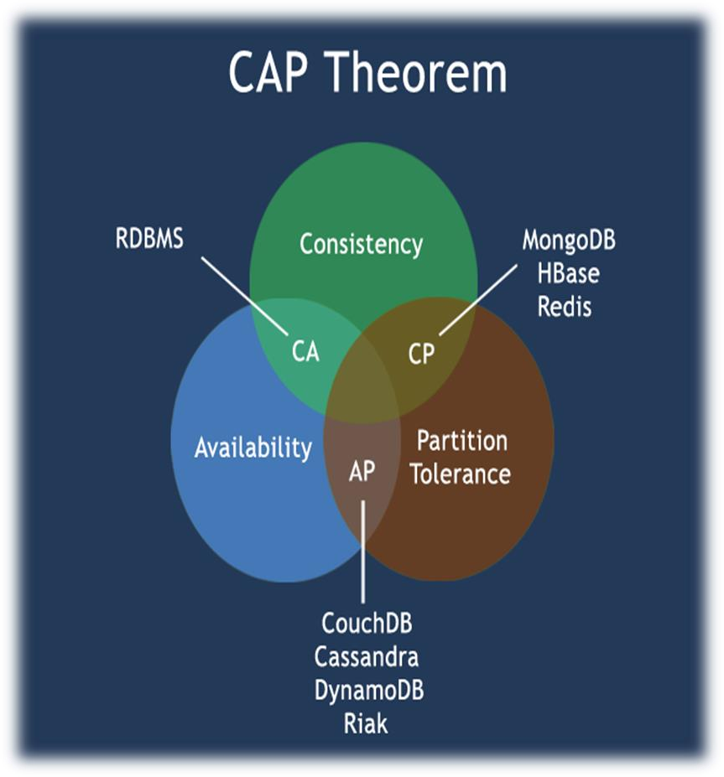
CAP Theorem
We can not achieve all the three items In distributed database systems (center)

Slide 48
CAP Theorem
It is not possible to guarantee all three of the desirable properties at the same time in a distributed system with data replication.
DS can choose any two properties
In a NOSQL distributed data store, a weaker consistency level is often acceptable, and guaranteeing the other two properties (availability, partition tolerance) is important.
Hence, weaker consistency levels are often used in NOSQL system instead of guaranteeing serializability. In particular, a form of consistency known as eventual consistency is often adopted in NOSQL systems

Slide 49
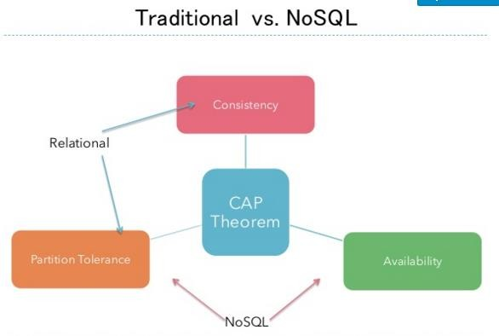
CAP theorem

Slide 50
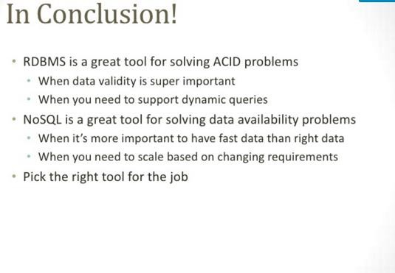
Conclusion….

Slide 51
nosql-database.org/
https://www.mongodb.com/nosql-explained
www.couchbase.com/nosql-resources/what-is-no-sql
http://nosql-database.org/ "NoSQL DEFINITION: Next Generation Databases mostly addressing some of the points: being non-relational, distributed, open- source and horizontally scalable“
NoSQL distilled, Martin Fowler
Please like and follow at www.slideshare.net/AshwaniKumar274

